Slide 1

AI Job Finder
Your Smart Career Companion
Making Job Search Easier, Faster, and Smarter
Team Members:-
LUCKY SISODIA
DEVANSHU JOSHI
AYUSHMAN
MANU AGARWAL
Team Leader
Concept, Algorithm & Flowchart Design
Programmer
Logic Development & Code Structure
Developer
Code Implementation & Testing
Researcher
Research & Documentation

Slide 2

The Problem: Job Search Challenges
Spending hours scrolling through countless job listings
Difficulty finding jobs that match your skills and interests
Applying to jobs that don't fit your qualifications
Getting lost in the overwhelming amount of information
Struggling to stand out among thousands of applicants
Wasting time on irrelevant job postings

Slide 3

The Solution: AI Job Finder
Smart matching between your skills and job requirements
Personalized job recommendations tailored to you
Saves time by filtering out irrelevant positions
Highlights jobs that are the best fit for your profile
Provides insights on how to improve your applications
Makes job searching simple, fast, and stress-free

Slide 4
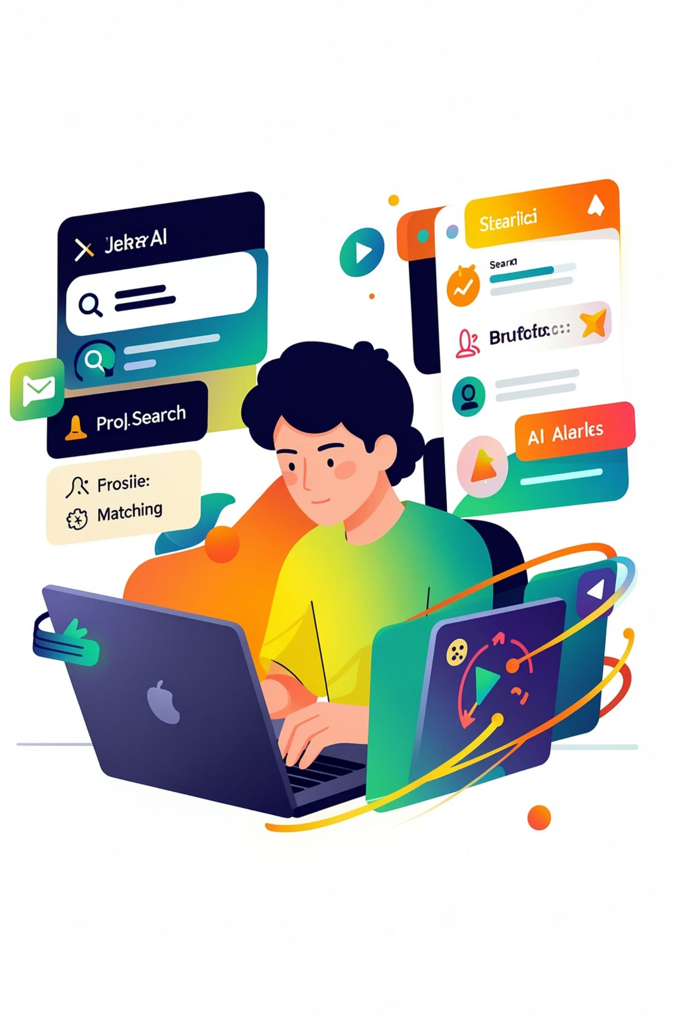




Key Features of AI Job Finder
Smart Matching
Compares your skills with job requirements automatically
Personalized Recommendations
Gets to know you and suggests perfect-fit jobs
Application Insights
Shows how your applications are performing and where to improve
Real-Time Updates
Alerts you instantly when new matching jobs are posted

Slide 5




Benefits of Using AI in Job Search
Save Time
Better Results
Smarter Decisions
Spend less time searching, more time preparing
Focus on quality applications instead of quantity
Find jobs that truly match your skills and goals
Increase your chances of getting interviews
Get data-driven insights about job market trends
Make informed choices about your career path
Build Confidence
Receive personalized tips to improve your profile
Feel more prepared and ready for applications

Slide 6




How AI Job Finder Works
Create Profile
AI Analyzes
Share your skills, experience, and goals.
It learns what you want.
Smart Matching
Get Recommendations
Finds jobs that fit.
Receive tailored suggestions.

Slide 7
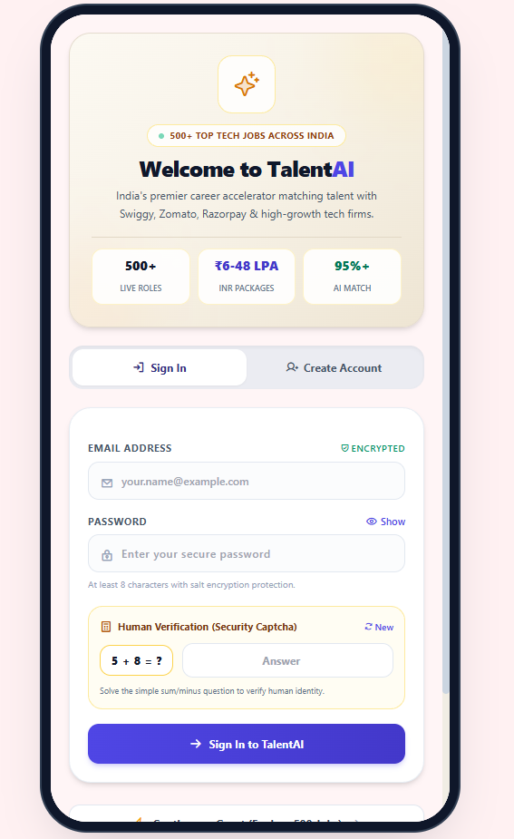
Welcome page

Slide 8
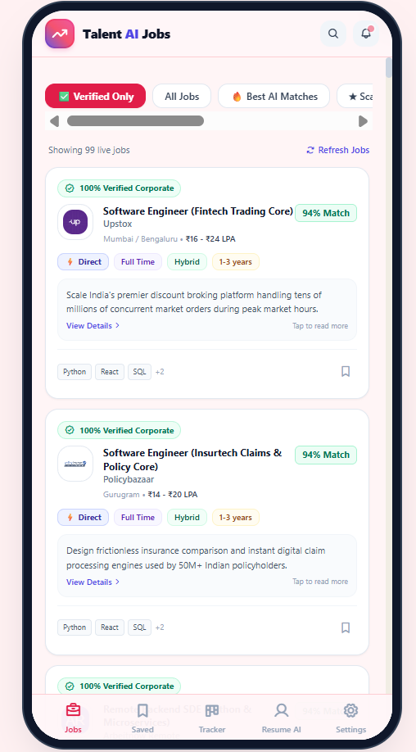
Jobs
Section

Slide 9
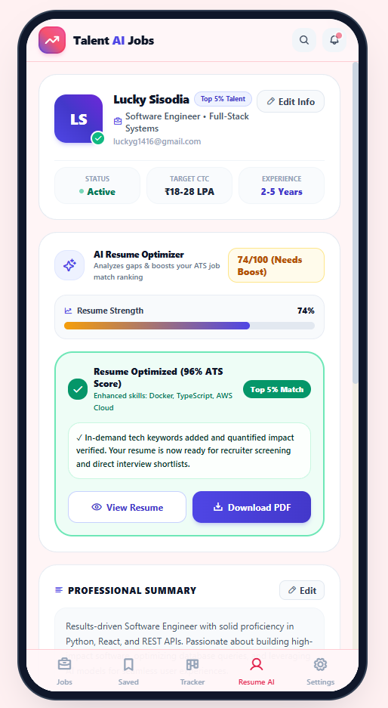
Profile and optimization

Slide 10
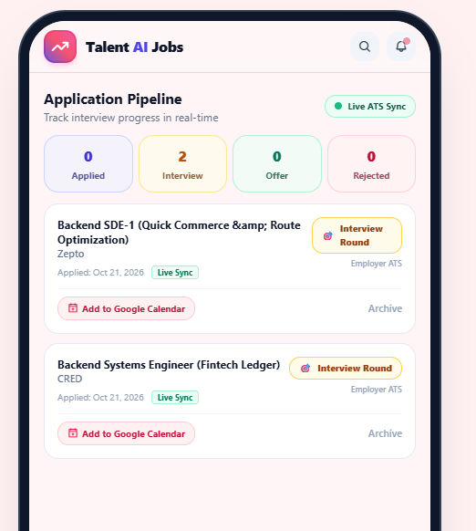
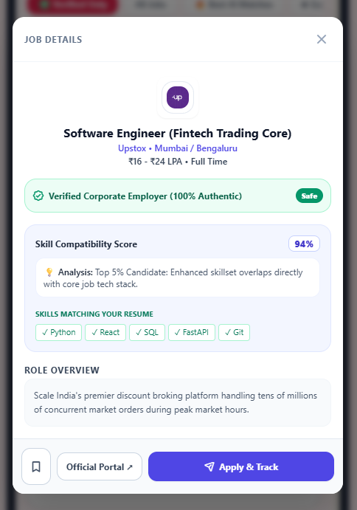
Where we apply
Where we see result

Slide 11



Technology Stack
Frontend Technologies
Backend Technologies
Data Structures
HTML, python
FLUTTER FLOW for UI components
Responsive design for mobile & desktop
Python for AI/ML algorithms
SUPABASE for server management
RESTful APIs for data communication
Arrays (for storing job listings)
Hash Maps (for quick skill matching)
Graphs (for job recommendation networks)
Trees (for hierarchical skill categorization)

Slide 12




Future Working & Enhancements
Phase 1 - Current Features
Phase 2 - Upcoming Features
Phase 3 - Advanced Features
Smart job matching algorithm
Personalized recommendations
Resume analysis and insights
Video interview preparation
Salary negotiation guidance
Career path planning
AI-powered cover letter generation
Job market trend predictions
Networking recommendations

Slide 13
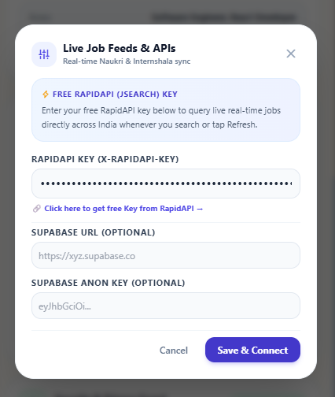
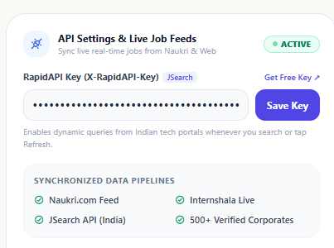
ADD YOUR SUPABASE
FOR NEW AND BETTER JOBS
ADD YOUR LINKDIN API

Slide 14
References & Sources
~ Documentation & Libraries
~ Academic & Industry Papers
TensorFlow Documentation: https://www.tensorflow.org
Scikit-learn Guide: https://scikit-learn.org
Fultterflow Official Docs: https://flutterflow.dev
SUAPBASE Documentation: https://docs.Supabase.com
"AI in Recruitment" - Harvard Business Review
"Machine Learning for Job Matching" - IEEE Papers
"Natural Language Processing in Resume Analysis" - ACM Digital Library
"Ethical AI in Hiring Systems" - Stanford AI Index Report

Slide 15

Thank You!
Thank you for your time. Our AI Job Finder highlights the power of artificial intelligence—turning the tedious job hunt into a fast, precise, and personalized experience

